Slide 1
Number’s
Counting by 5’s

Slide 6
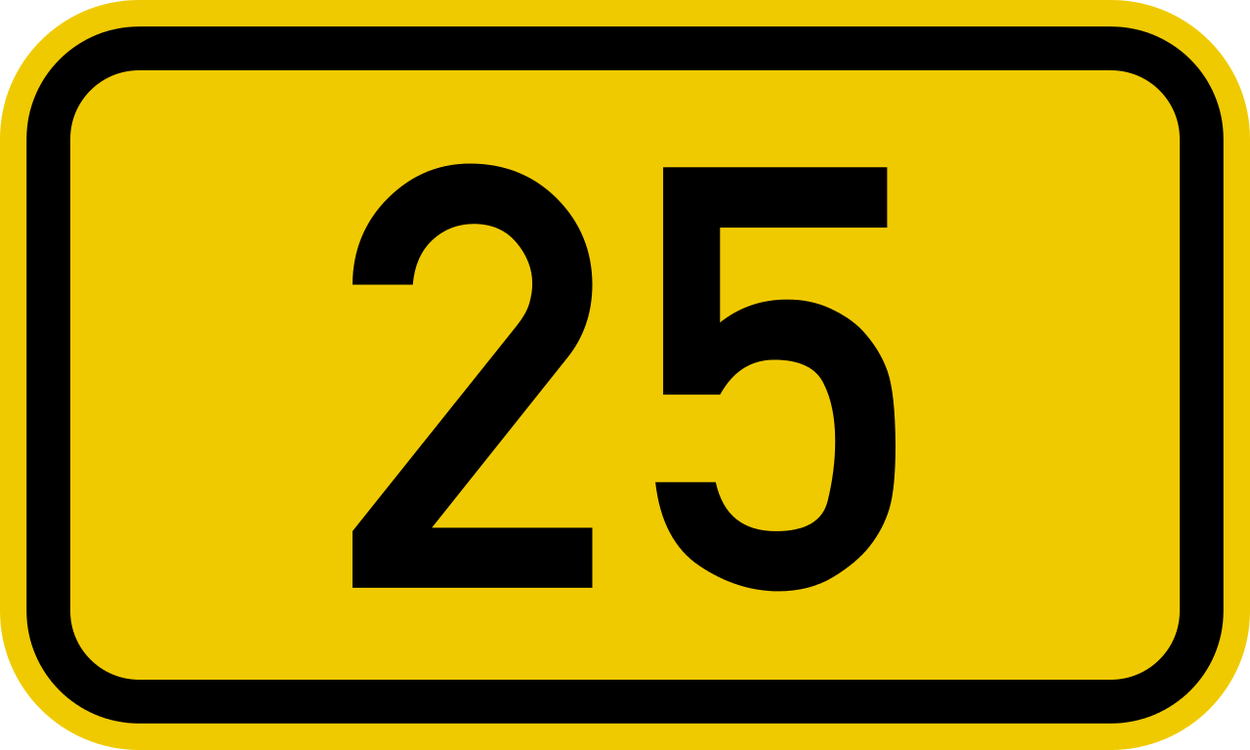

Slide 14
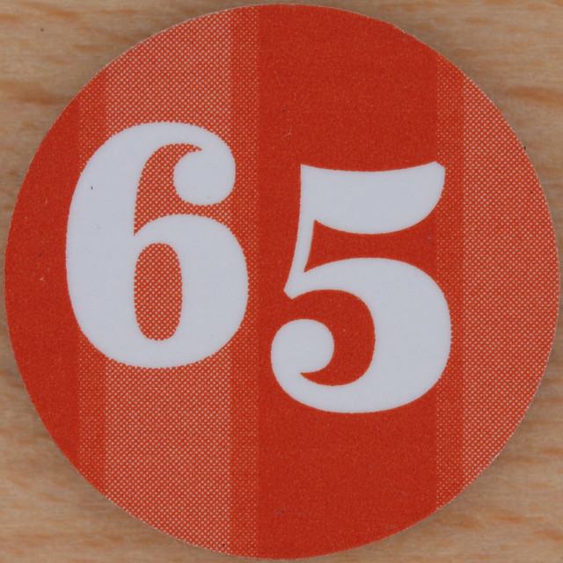

Slide 20
